Slide 1










Research Proposal Presentation
RESEARCH TOPIC
Adaptive Learner Centric LMS: Enhanced Student Engagement and Personalized Learning Experiences
24-25J-112

Slide 2







OUR TEAM
24-25J-112
Supervisor
Co-Supervisor​
Dr. Kalpani Manathunga
Ms. Thilini Jayalath​
IT21251900​
IT21302862​
IT21302862
IT21360428​
Rajapaksha R.M.S.D. ​
Sri Samadhi L.A.S.S ​
Peiris A.R.D.
Monali G.M.N.​

Slide 3
1 | Introduction
2 | Research Question
3 | Objectives
4 | System Diagram
5 | Individual Components
6 | Commercialization
Agenda

Slide 4


INTRODUCTION
“Implementation of an Adaptive Learner-Centric Learning Management System to address the Challenges in Current LMS”
Inadequate Communication​
Teacher-Centered Approach​
Low Engagement​
Rigid Assessments​
No Customisability in the UI
2024-25J-112

Slide 5
RESEARCH QUESTION​
“How does the implementation of an Adaptive Learner-Centric Learning Management System (LMS) impact student engagement, autonomy, and motivation compared to traditional LMS implementations?​”
2024-25J-112

Slide 6
OBJECTIVES​
Enhance Student Engagement​
Personalize Learning Experiences​
Improve Communication Features​
Shift to Learner-Centric Approach​
Utilize Interactive, Adaptive Content​
Create Supportive Educational Environment​
2024-25J-112

Slide 7

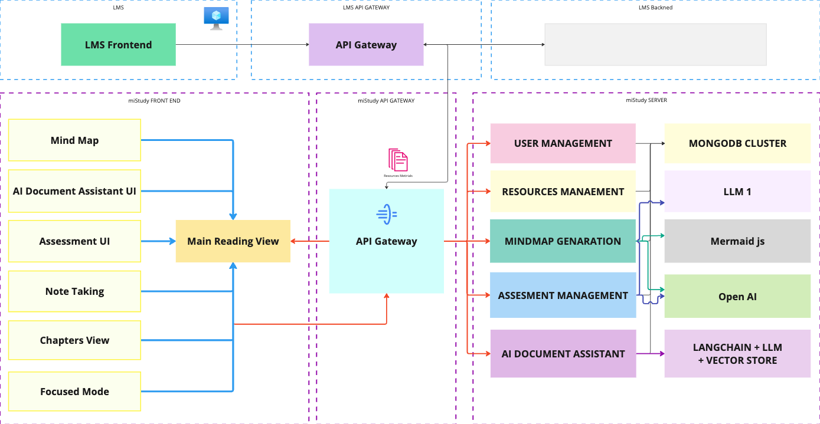
SYSTEM DIAGRAM
2024-25J-112

Slide 8




IT21251900 | RAJAPAKSHA R.M.S.D
SPECIALIZATION
SOFTWARE ENGINEERING
IT21251900 | RAJAPAKSHA R.M.S.D | 2024-25J-112

Slide 9

Keep students engaged in a learning environment
Incorporate study techniques.
Implement all rounded interface.
IT21251900 | RAJAPAKSHA R.M.S.D | 2024-25J-112

Slide 10

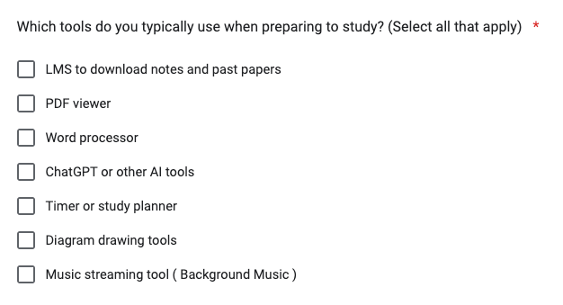
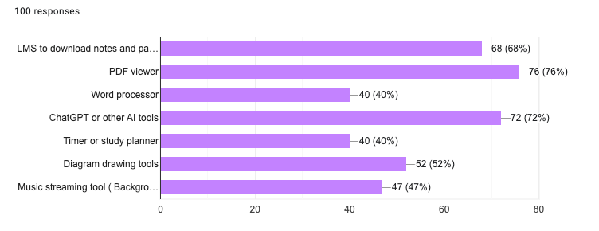
INTRODUCTION - BACKGROUND
Figure 2.1
Results of a survey conducted around 100
university / collage students who daily uses LMSs in 2024
IT21251900 | RAJAPAKSHA R.M.S.D | 2024-25J-112

Slide 11
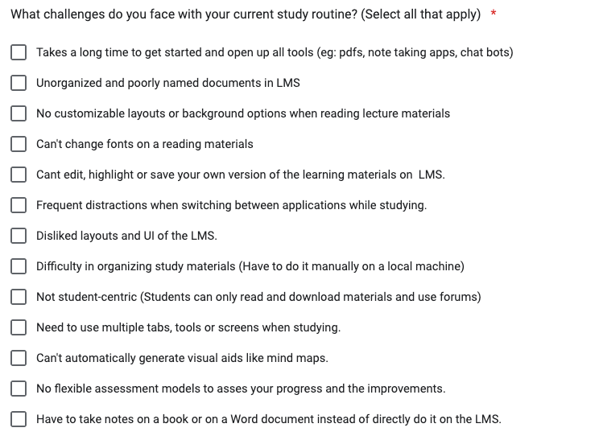

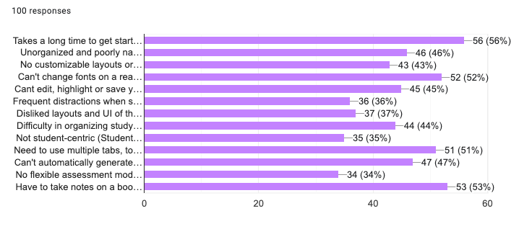
Introduction - Problems
Waste of time
Disengagement
Procrastination
Unorganized Content
Lack of Customizability
Figure 2.2
Results of a survey conducted around 100
university / collage students who daily uses LMSs in 2024
IT21251900 | RAJAPAKSHA R.M.S.D | 2024-25J-112

Slide 12

Introduction - Gap
“Research at Kathmandu University School of Education (KUSOED) in Nepal revealed that poor structures in their LMS contributed to significant learner disengagement. This finding emphasizes the critical role of well-designed, user-friendly course layouts in keeping students engaged and active in their learning.” [1]
“Procrastination, often linked to anxiety and perfectionism, leads to delayed tasks, increased stress, and lower academic performance. Similarly, poorly structured courses can cause learner disengagement, reducing participation and motivation, further hindering academic success..” [3]
IT21251900 | RAJAPAKSHA R.M.S.D | 2024-25J-112

Slide 13
Research Question
How to build a personalised adaptive leaning environment with build in study techniques?
IT21251900 | RAJAPAKSHA R.M.S.D | 2024-25J-112

Slide 14
Specific and Sub Objectives
Incorporate study techniques
To find what are the best study techniques that can improve learning.
To find which of them can be incorporated into an online learning environment and how.
To find a way to make the whole interaction personal.
Incorporate all the tools into one interface effectively.
To find what are the most needed tools for the students when studying.
How to precent everything in less distractive and attractive manner.
To find how to balance the client-side load and optimize the system.
IT21251900 | RAJAPAKSHA R.M.S.D | 2024-25J-112

Slide 15
Research Areas
Human computer interaction
User Interface and Experience Design
Behavioral Psychology
Educational Technology
Motivation and Engagement / Learning Behaviors
Learning Techniques / E-Learning Platforms
Software Engineering
Cognitive Science
Optimization, Scalability and Performance
Memory and Retention/Cognitive Load Management
IT21251900 | RAJAPAKSHA R.M.S.D | 2024-25J-112

Slide 16
Related Work
 | Techniques used | Proven | Personalized | Tested Online | Used in LMS
Research 01 [2] | Pomodoro + Forest app | ✓ | X | ✓ | ✓
Research 02 [3] | Pomodoro | ✓ | X | ✓ | X
Research 03 [4] | Pomodoro | ✓ | X | ✓ | X
Research 04 [5] | Spaced Repetition | ✓ | X | X | X
Research 05 [6] | Feynman | ✓ | X | X | X
Research 06 [7] | Background Music | ✓ | X | ✓ | X
Article [8] | Flowtime | ✓ | ✓ | ✓ | X
Video [9] | Flowtime + pomodoro | X | ✓ | X | X
Our Solution | Need to Choose | - | ✓ | ✓ | ✓
IT21251900 | RAJAPAKSHA R.M.S.D | 2024-25J-112

Slide 17
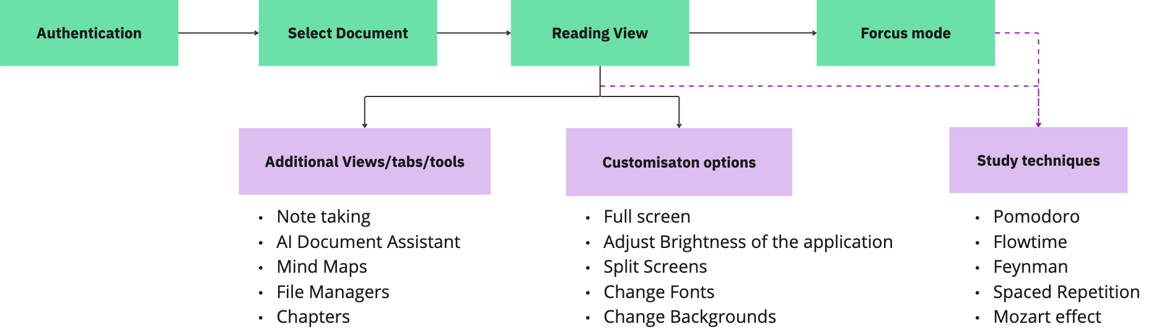
Methodology
IT21251900 | RAJAPAKSHA R.M.S.D | 2024-25J-112

Slide 18
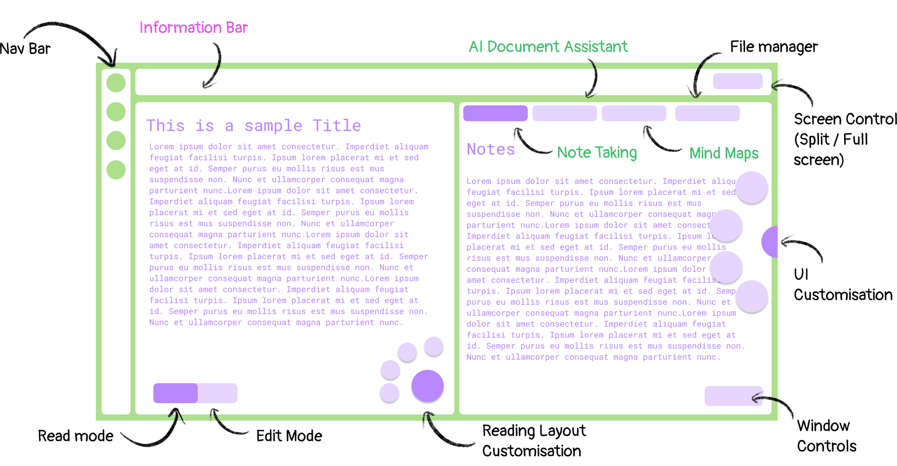
UI Elements
IT21251900 | RAJAPAKSHA R.M.S.D | 2024-25J-112

Slide 19

Technologies and Techniques
Technologies | Techniques
Angular or React | Pomodoro
Express | Flowtime
Nodejs | Feynman
Mongo DB | Spaced Repetition
Cloudanary | Mozart effect
IT21251900 | RAJAPAKSHA R.M.S.D | 2024-25J-112

Slide 20
Requirments
Functional | Non Functional
Study Techniques Integration Display Course Contents Customizable Layouts | Usability Performance Optimization Scalability
IT21251900 | RAJAPAKSHA R.M.S.D | 2024-25J-112

Slide 21
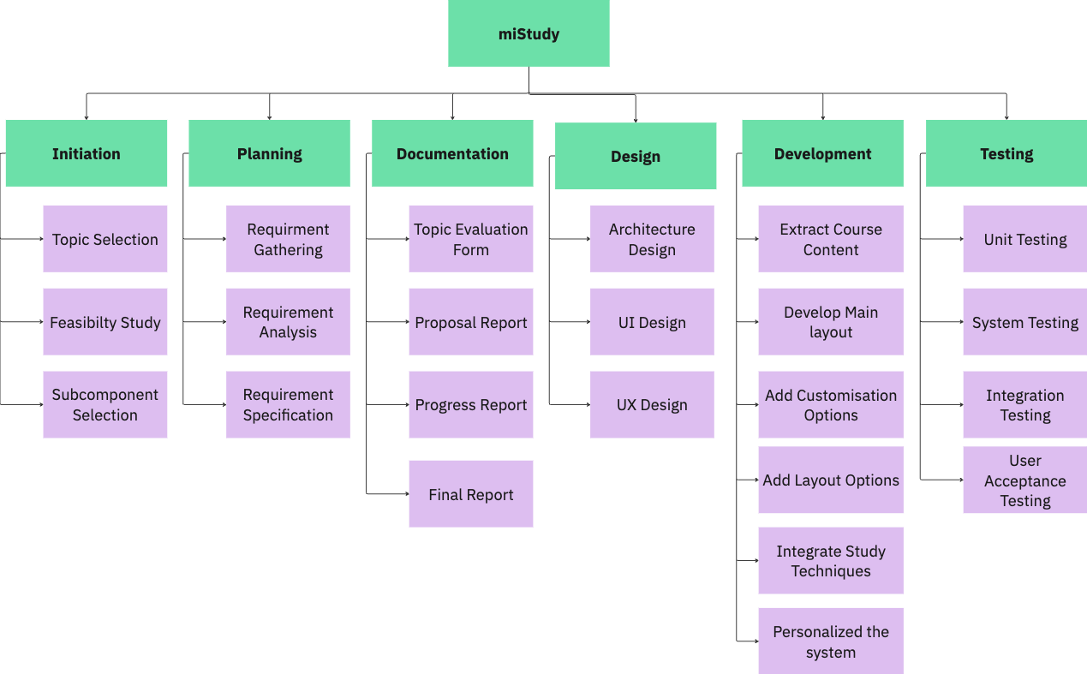
Work breakdown
IT21251900 | RAJAPAKSHA R.M.S.D | 2024-25J-112

Slide 22
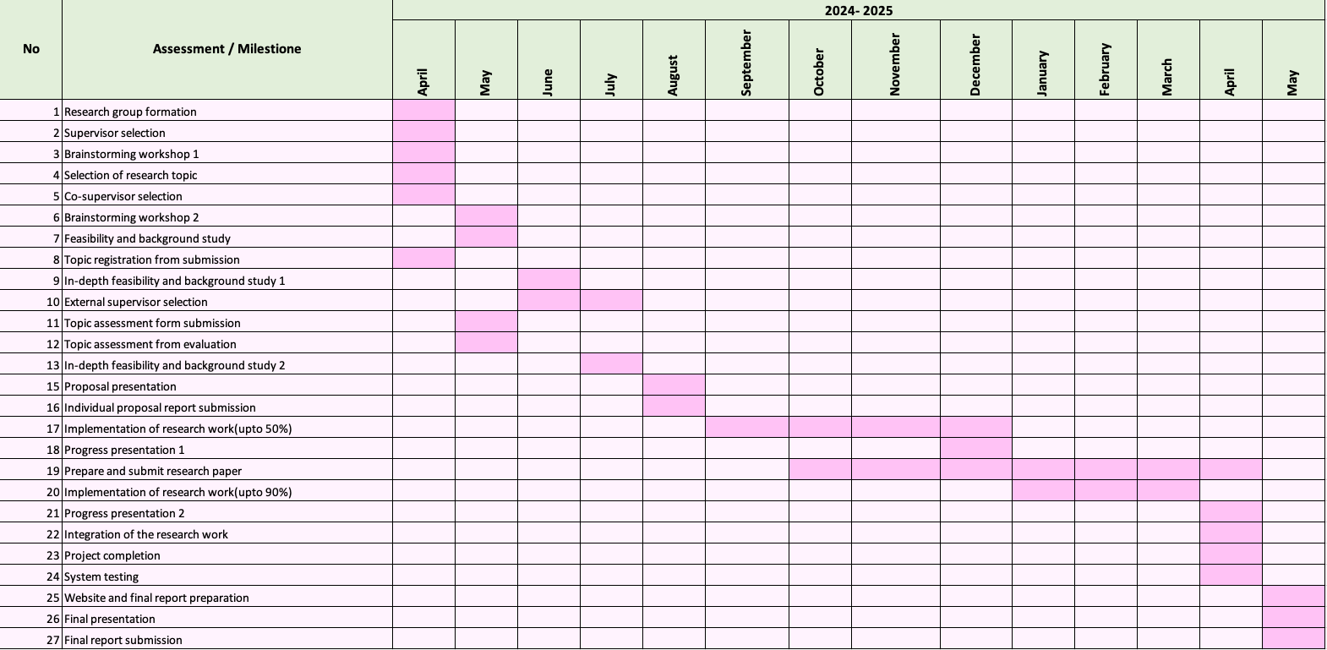
Gantt Chart
IT21251900 | RAJAPAKSHA R.M.S.D | 2024-25J-112

Slide 23
[ 1 ] | Dahal, N., & Manandhar, N. K. (2024). The reality of e-Learning: Success and failure of learning management system. Advances in Mobile Learning Educational Research, 4(1), 903-910. Shilowaras, Mahendran & Nor Amizam, Jusoh. (2022). Implementing Artificial Intelligence Chatbot in Moodle Learning Management System. Engineering, Agriculture, Science and Technology Journal
[ 2 ] | Arazo, Erika and Durana, Ma. Robelene and Umali, Abegail and Almazan, Rona Christina, Online Learning Self-Efficacy as Correlates to Academic Procrastination among Pre-Service Teachers (May 16, 2023). International Journal of Scientific and Management Research. 6(5) 171-187. http://doi.org/10.37502/IJSMR.2023.6508, Available at SSRN: https://ssrn.com/abstract=4454770
[ 3 ] | Almalki, K., Alharbi, O., Al-Ahmadi, W., Aljohani, M. (2020). Anti-procrastination Online Tool for Graduate Students Based on the Pomodoro Technique. In: Zaphiris, P., Ioannou, A. (eds) Learning and Collaboration Technologies. Human and Technology Ecosystems. HCII 2020. Lecture Notes in Computer Science(), vol 12206. Springer, Cham. https://doi.org/10.1007/978-3-030-50506-6_10
[ 4 ] | Almalki, K., Alharbi, O., Al-Ahmadi, W., Aljohani, M. (2020). Anti-procrastination Online Tool for Graduate Students Based on the Pomodoro Technique. In: Zaphiris, P., Ioannou, A. (eds) Learning and Collaboration Technologies. Human and Technology Ecosystems. HCII 2020. Lecture Notes in Computer Science(), vol 12206. Springer, Cham. https://doi.org/10.1007/978-3-030-50506-6_10
[ 5 ] | Kang, S. H. K. (2016). Spaced Repetition Promotes Efficient and Effective Learning: Policy Implications for Instruction. Policy Insights from the Behavioral and Brain Sciences, 3(1), 12-19. https://doi.org/10.1177/2372732215624708
[ 6 ] | Reyes, E. P., Blanco, R. M. F. L., Doroon, D. R. L., Limana, J. L. B., & Torcende, A. M. A. (2021). Feynman Technique as a Heutagogical Learning Strategy for Independent and Remote Learning. Recoletos Multidisciplinary Research Journal, 9(2), 1–13. https://doi.org/10.32871/rmrj2109.02.06
[ 7 ] | Angel, L. A., Polzella, D. J., & Elvers, G. C. (2010). Background Music and Cognitive Performance. Perceptual and Motor Skills, 110(3_suppl), 1059-1064. https://doi.org/10.2466/pms.110.C.1059-1064
[ 8 ] | Herman, "How to Use the Flowtime Technique to Get More Work Done," ClickUp, Jan. 2, 2023. [Online]. Available: https://clickup.com/blog/flowtime-technique/#:~:text=The%20Flowtime%20Technique%20offers%20a,and%20allowing%20for%20natural%20breaks. [Accessed: Aug. 4, 2024].
[ 9 ] | "Flowtime Technique Explained," YouTube, Jan. 20, 2023. [Online]. Available: https://www.youtube.com/watch?v=olX0mXl1B9s&list=LL&index=2. [Accessed: Aug. 4, 2024].
References
IT21251900 | RAJAPAKSHA R.M.S.D | 2024-25J-112

Slide 24
IT21249266 | PEIRIS A R D
SPECIALIZATION
SOFTWARE ENGINEERING
IT21249266 | PEIRIS ARD | 2024-25J-112

Slide 25


AI Document Assistant
Facilitate Self-Directed Learning
IT21249266 | PEIRIS ARD | 2024-25J-112

Slide 26
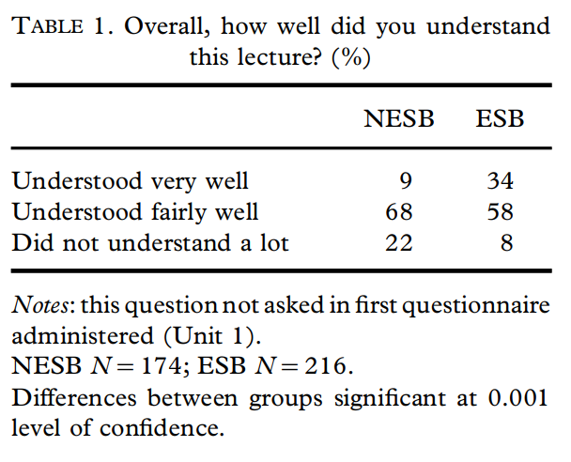
Introduction - Background
The traditional education system faces several issues, including a lack of personalized attention for students, varying learning paces and styles[1].
A student who struggles to understand, and if fails to receive adequate clarfication from the lecturer, may develop a knowledge gap.
Such students depend on AI to fill their knowledge gaps.
Figure 1
Source: How Much Do They Understand?
IT21249266 | PEIRIS ARD | 2024-25J-112

Slide 27
Research Gap
 | AI Document Assistant | Most suitable LLM for Education | AI Chatbots in LMS | Concerns in integrating AI to Education
[ 1] | X | X | ✓ | X
[2] | X | X | ✓ | ✓
[3] | X | X | X | ✓
[4] | X | X | X | X
Our system | ✓ | ✓ | ✓ | ✓
Implementing Artificial Intelligence Chatbot in Moodle Learning Management System.
Role of AI chatbots in education: systematic literature review.
Enhancing Student Engagement Through Artificial Intelligence (AI): Understanding the Basics, Opportunities, and Challenge
A Meta-Analysis and Systematic Review of the Effect of Chatbot Technology Use in Sustainable Education
IT21249266 | PEIRIS ARD | 2024-25J-112

Slide 28
Research Gap
Current Focus: Most research has explored how AI can impact education broadly, there is limited exploration of integrating AI document assistants directly within Learning Management Systems (LMS).
Local Context: There are currently no specific LMS platforms locally that facilitates an AI assistant, providing an opportunity for innovation.
LLM Suitability: A gap exists in identifying the most suitable Large Language Model (LLM) for educational purposes within LMS environments.
Concerns: Integrating AI into education raises concerns about data privacy, ethical implications, and the potential for over-reliance on AI in learning processes.
IT21249266 | PEIRIS ARD | 2024-25J-112

Slide 29
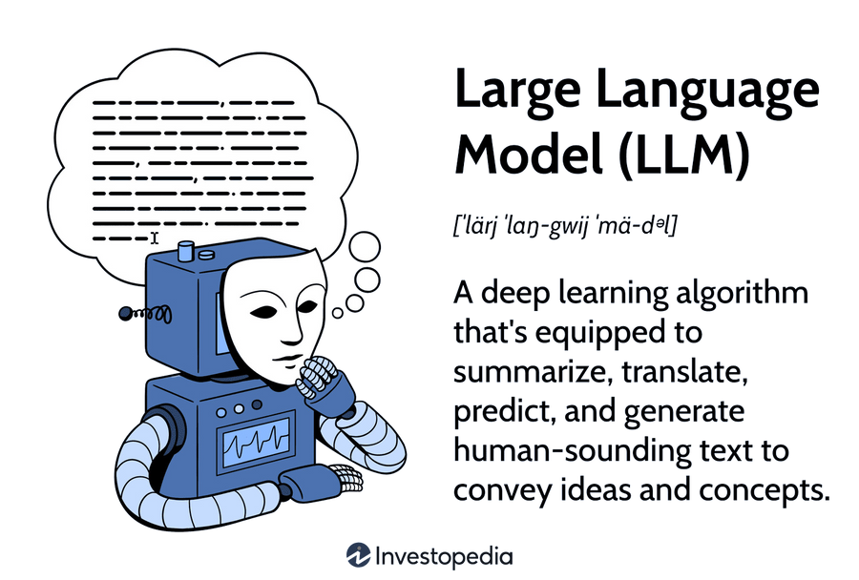

Research Question
Model Suitability: Which Large Language Model (LLM) is most suitable for enhancing educational experiences within an LMS?
Impact on Learning: How can the integration of a document assistant into an LMS improve student learning performance?
Integration Concerns: What concerns might arise when integrating AI chatbots into a Learning Management System (LMS), and how can they be addressed?
IT21249266 | PEIRIS ARD | 2024-25J-112

Slide 30
Specific and Sub Objectives
Primary Objective
Facilitating self directed learning by developing an AI Document Assistant through a form of chatbot interface.
Sub Objectives
To design the system so that it can be easily integrated into other LMS platforms as a third-party tool.
Ensure Scalability and Adaptability
IT21249266 | PEIRIS ARD | 2024-25J-112

Slide 31
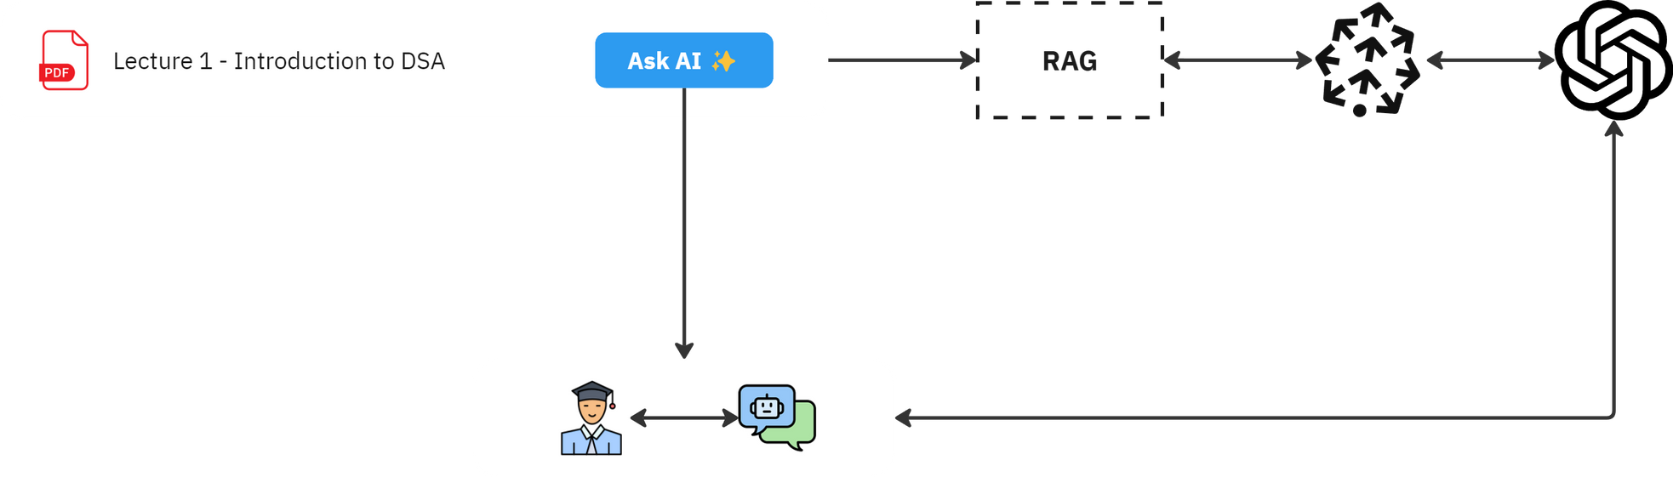
Methodology
IT21249266 | PEIRIS ARD | 2024-25J-112

Slide 32
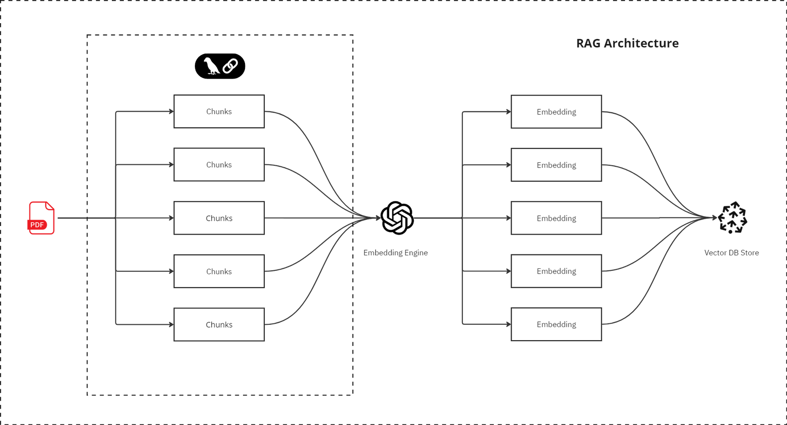
Methodology
IT21249266 | PEIRIS ARD | 2024-25J-112

Slide 33
Requirments
Functional | Non Functional
Document Ingestion Chatbot Interaction Data retrievel | Usability Scalability Compliance
IT21249266 | PEIRIS ARD | 2024-25J-112

Slide 34
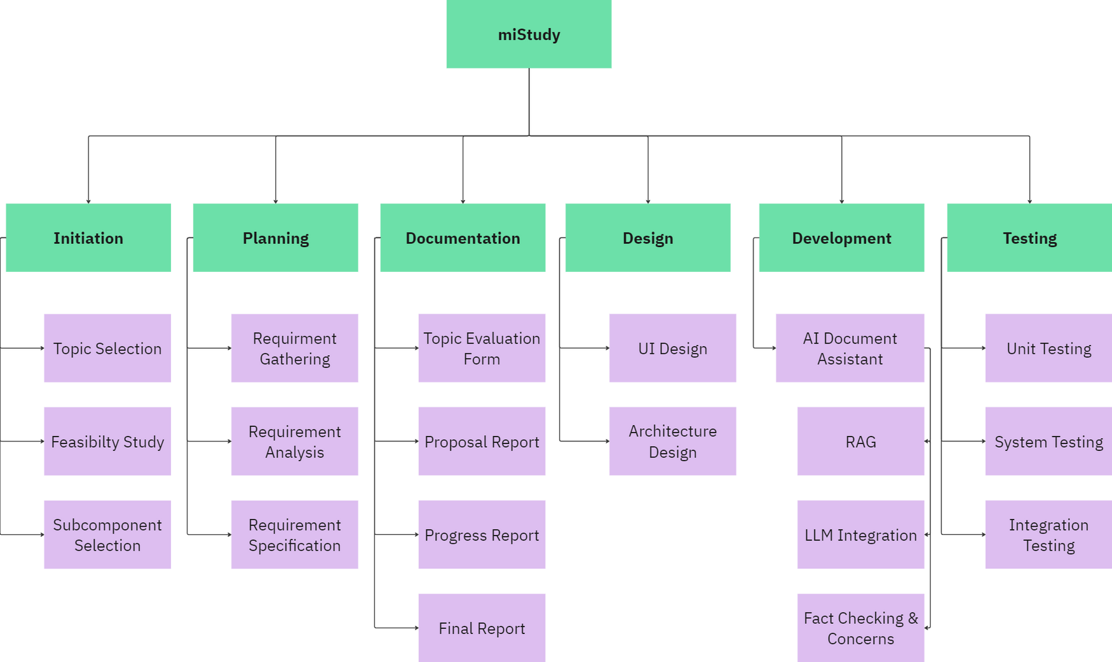
Work breakdown
IT21249266 | PEIRIS ARD | 2024-25J-112

Slide 35
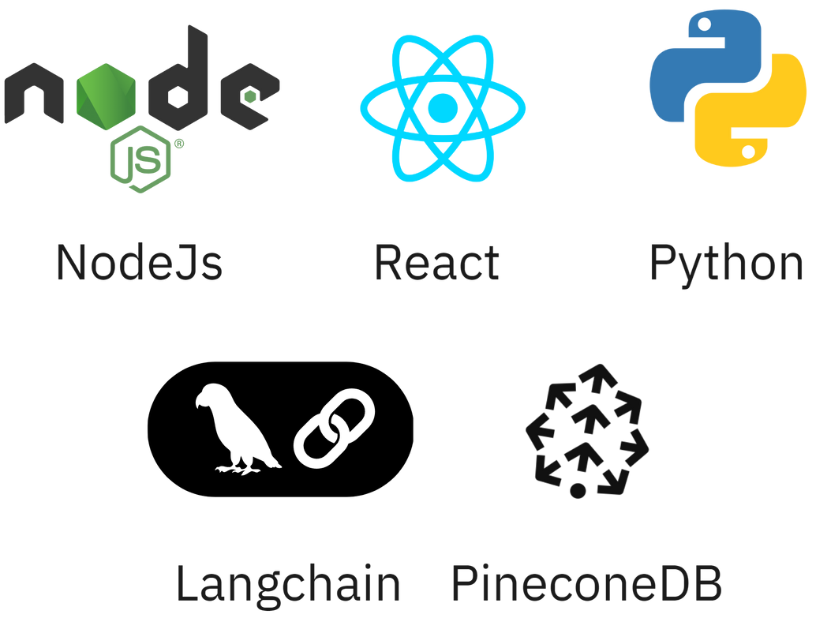
Technologies
IT21249266 | PEIRIS ARD | 2024-25J-112

Slide 36
Gantt Chart
IT21249266 | PEIRIS ARD | 2024-25J-112

Slide 37
References
[ 1] | Shilowaras, Mahendran & Nor Amizam, Jusoh. (2022). Implementing Artificial Intelligence Chatbot in Moodle Learning Management System. Engineering, Agriculture, Science and Technology Journal
[2] | Labadze, L., Grigolia, M. & Machaidze, L. Role of AI chatbots in education: systematic literature review. Int J Educ Technol High Educ 2023
[3] | Nguyen, Andy & Kremantzis, Marios Dominikos & Essien, Ani & Petrounias, Ilias & Hosseini, Samira. (2024). Enhancing Student Engagement Through Artificial Intelligence (AI): Understanding the Basics, Opportunities, and Challenges. Journal of University Teaching and Learning Practice.
[4] | Deng, X.; Yu, Z. A Meta-Analysis and Systematic Review of the Effect of Chatbot Technology Use in Sustainable Education. Sustainability 2023
IT21249266 | PEIRIS ARD | 2024-25J-112

Slide 38
IT21302862|SRI SAMADHI L.A.S.S
SPECIALIZATION
SOFTWARE ENGINEERING
IT21302862 | SRI SAMADHI LASS | 2024-25J-112

Slide 39
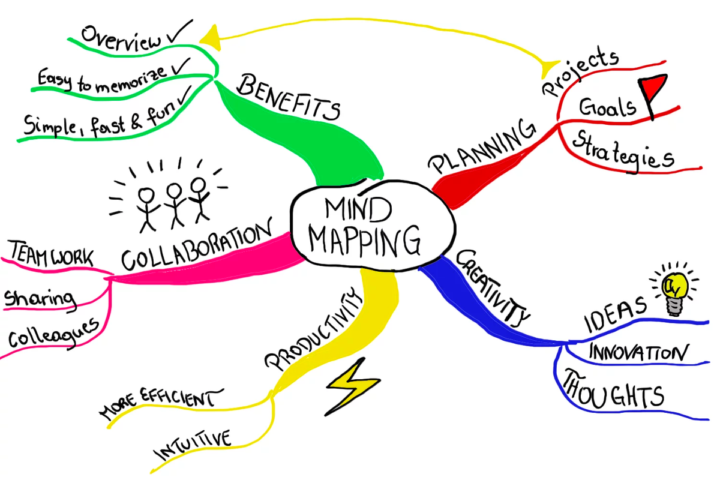
Research Component
Interactive mind maps tailored to individual learners.
Continuous evolution of mind maps in real-time
IT21302862 | SRI SAMADHI LASS | GROUP

Slide 40
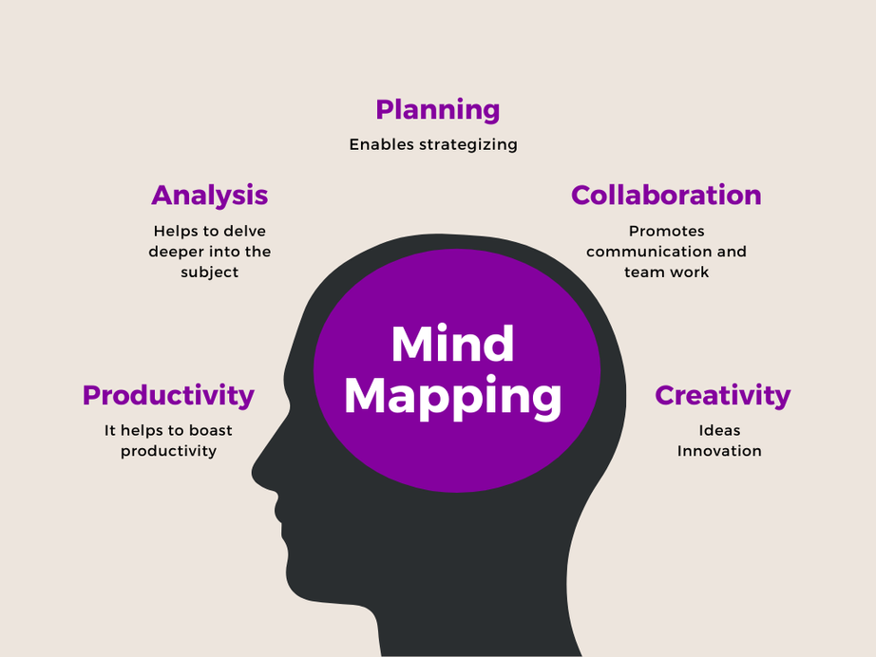
Introduction - Background
What is a mind map?
A mind map is a diagram used to visually organize information into a hierarchy, showing relationships among pieces of the whole.[4].
Why mind map important?
Mind maps help organize complex information by breaking it into a clear, hierarchical structure. This method enhances creativity, problem-solving, and focus on the main subject while exploring related details.[1]
Effective mind maps simplify complex information, enhance memory retention, and improve understanding by visually organizing key concepts and their relationships.
Figure 1
Source: How Much Mind Maps Important?
IT21302862 | SRI SAMADHI LASS | 2024-25J-112

Slide 41
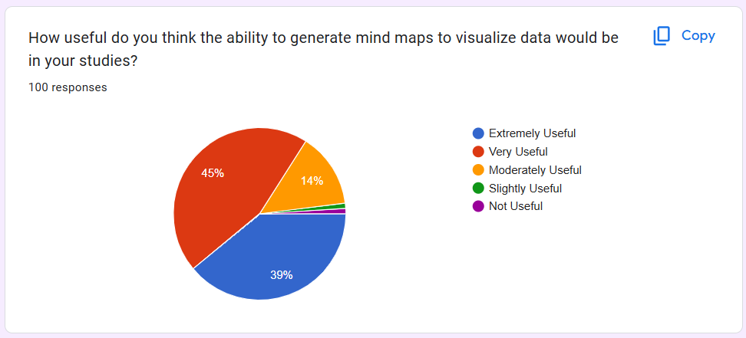
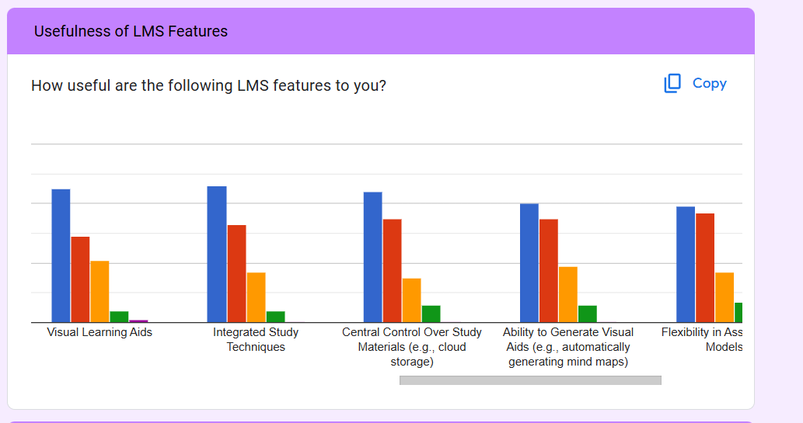
Survey Analysis

Slide 42
Research Gap
 | Interactive Elements | Personalized | Used in LMS | Online Environment
[ 1] | X | X | ✓ | ✓
[2] | X | X | X | ✓
[3] | X | X | X | X
[4] | X | X | X | X
Our system | ✓ | ✓ | ✓ | ✓
Research 01-Mind maps to guide student questioning effectively supported students in progressing[1]
Research 02-Mind mapping as an online learning and group assessment tool in two medical physics courses during the COVID-19 pandemic.[2]
Research 03-Mind Map Learning Technique (MMLT) significantly improved nursing students' learning outcomes[3]
Research 04-Mind maps markedly increased student motivation and facilitated better integration of theoretical and empirical knowledge[4]
IT21302862 | SRI SAMADHI LASS | 2024-25J-112

Slide 43
Research Gap
Many existing tools have complex interfaces that are not user-friendly for diverse educational contexts.[4]
Standardized templates in many tools do not adapt to individual learning styles and preferences, leading to less effective learning.[5]
Traditional mind maps are static and lack interactive elements like multimedia contents and references, which can enhance engagement and understanding.
Poor Integration with Educational Ecosystems
IT21302862 | SRI SAMADHI LASS | GROUP

Slide 44


Research Question
How does the personalization of mind maps based on initial assessments impact student engagement and learning outcomes?
What is the role of integrated references and further reading materials in supporting student comprehension and further learning?
What is the impact of interactive mind maps on students' cognitive processing and retention of complex information?
IT21302862 | SRI SAMADHI LASS | 2024-25J-112

Slide 45

Main Objective
Create an adaptive and interactive mind map generation in the LMS that customizes visualizations based on initial assessments and individual learning progress, enhancing the personalization of the learning journey by providing tailored content, allowing access to additional resources, and engaging learners with customized visualizations.
IT21302862 | SRI SAMADHI LASS | 2024-25J-112

Slide 46
Sub Objectives
Identify the most effective tool for creating and managing mind maps.
Use grading and assessment data to tailor the mind map generation, reflecting individual learning needs and progress.
Provide tools for users to search and navigate through different nodes and branches of the mind map easily.
Embed links to supplementary resources such as articles, videos, and external websites relevant to the content of each mind map node.
Use user performance data to continuously adapt and improve the mind map generation process.
IT21302862 | SRI SAMADHI LASS | 2024-25J-112

Slide 47

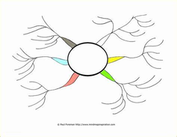





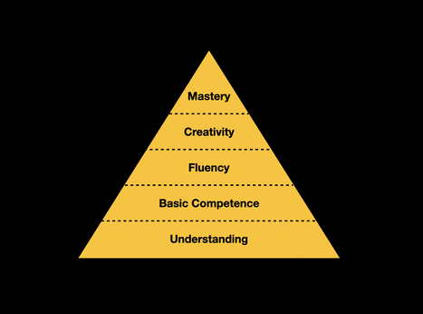
Methodology
Generate Mind Map
Mongo DB
Intelligent system
Input lecture content
Mermaid js
Web Application
Intelligent system
levels Identification
IT21302862 | SRI SAMADHI LASS | 2024-25J-112

Slide 48
Technologies and Techniques
Technologies | Techniques
Angular or React | Zoom and Pan
Express | Data Pre-processing
Nodejs,Mermaid Js | Node Expansion/Collapse
Mongo DB | Adaptive Learning Technique

Slide 49
Requirments
Functional Requirements | Non Functional Requirements | Ethical Requirements | System Requirements
Mind Map Generation Resource Integration Personalization | Performance Scalability Usability Reliability | Data Protection Bias and Fairness Transparency | Development Tools Storage Processing Power
IT21302862 | SRI SAMADHI LASS | 2024-25J-112

Slide 50
Work breakdown
MiStudy
Initiation
Planing
Design
Implementation
Testing
Closeout
Submitting the
Topic
Assessment
Form
Requirement
Gathering
Create use
case
diagram
Data
Preprocessing
Unit Testing
Publish the
research paper
Create
Sequence
diagram
Development Setup
Integration
Testing
Host the
application
Requirement
Analysis
Creating the
project proposal
Create
architectural
diagram
Feature Development
System
Testing
Final
presentation
Feasibility
Study
Requirement
Gathering
Non-Functi
onal
Testing
Integration
Applying for permission
to commercialize the
product from the
relevant authorities
Design UI prototypes for Web
application
Implementation of web application
User
Acceptance
Testing

Slide 51
Gantt Chart
IT21302862 | SRI SAMADHI LASS | 2024-25J-112

Slide 52
References
[ 1] | Stokhof, Harry, Bregje De Vries, Theo Bastiaens, and Rob Martens. "Using mind maps to make student questioning effective: Learning outcomes of a principle-based scenario for teacher guidance." Research in Science Education 50, no. 1 (2020): 203-225.https://link.springer.com/article/10.1007/s11165-017-9686-3
[2] | Alsuraihi, Amany A. "The effect of implementing mind maps for online learning and assessment on students during COVID-19 pandemic: a cross sectional study." BMC medical education 22.1 (2022): 169. https://bmcmededuc.biomedcentral.com/articles/10.1186/s12909-022-03211-2
[3] | Rezapour-Nasrabad, Rafat. "Mind map learning technique: An educational interactive approach." International Journal of Pharmaceutical Research 11, no. 1 (2019): 1593-1597. https://www.researchgate.net/profile/Rafat-Rezapour-Nasrabad/publication/335201941_Mind_Map_Learning_Technique_An_Educational_Interactive_Approach/links/5d563dd992851cb74c6fa5a5/Mind-Map-Learning-Technique-An-Educational-Interactive-Approach.pdf
IT21302862 | SRI SAMADHI LASS | 2024-25J-112

Slide 53
References
[ 4] | Stankovic, Nebojsa, Carisa Besic, Milos Papic, and Veljko Aleksic. "The evaluation of using mind maps in teaching." Technics technologies education management 6, no. 2 (2011): 337-343. The evaluation of using mind maps in teaching https://www.researchgate.net/profile/Veljko-Aleksic/publication/272792319_The_evaluation_of_using_mind_maps_in_teaching/links/56eb99f608ae9dcdd82adf79/The-evaluation-of-using-mind-maps-in-teaching.pdf?origin=journalDetail&_tp=eyJwYWdlIjoiam91cm5hbERldGFpbCJ9
[5] | Šimonová, Ivana. "E-learning in higher education: Reflection of the term in mind maps." ICTE Journal 4, no. 1 (2015): 16-27. https://periodika.osu.cz/ictejournal/dokumenty/2015-01/ictejournal-2015-1.pdf#page=16
[6] | Badriah, Liah, Susriyati Mahanal, Betty Lukiati, and Murni Saptasari. "Collaborative Mind Mapping-Assisted RICOSRE to Promote Students’ Problem-Solving Skills." Participatory Educational Research 10, no. 4 (2023): 166-180. https://dergipark.org.tr/en/pub/per/issue/77295/1185993
IT21302862 | SRI SAMADHI LASS | 2024-25J-112

Slide 54
IT21360428 | MONALI G M N
SPECIALIZATION
SOFTWARE ENGINEERING
IT21360428 | MONALI G.M.N. | 24-25J-112

Slide 55

Enhanced Personalized Learning Experience
Adaptive Quizzes and Assignments
IT21360428 | MONALI G.M.N. | 24-25J-112

Slide 56
Introduction - Background
This component focuses on making learning more personalized by creating quizzes and assignments that adjust to each student's needs.
This includes tracking progress, giving flexible assessments, and providing personalized feedback.
Why are adaptive quizzes and assignments important?
This creates a personalized learning environment by adjusting the difficulty and content of assessments based on individual performance, these tools meet each student's unique learning needs and pace [4].
IT21360428 | MONALI G.M.N. | 24-25J-112

Slide 57
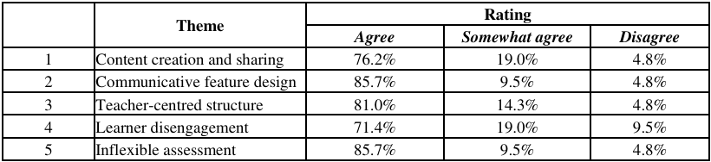
Research Gap
While many systems offer general learning tools, they often lack the ability to adapt to each student’s unique learning needs and pace [5].
Current educational tools often provide limited personalization, ineffective assessments, delayed feedback, and lack a strong support system[1]-[4].
Gap in Approach: There is a need for implementing adaptive quizzes and assignments that cater to individual learning needs, developing varied assessment tools that align with personal learning goals, and providing automated grading and feedback for quicker learning adjustments.
Figure 1
Source: LMS Failure Aspects Rating
IT21360428 | MONALI G.M.N. | 24-25J-112

Slide 58
Research Gap
 | Support System | Personalized | Grading | Used in lms | Feedback
[ 1] | X | ✓ | X | ✓ | ✓
[2] | X | X | X | ✓ | X
[3] | X | X | X | X | X
[4] | X | X | X | X | X
Our system | ✓ | ✓ | ✓ | ✓ | ✓
Personalized Quiz Maker: Novel feature for Alby learning management system.
A Quiz Generator Extension inside CMS for Mathematics Learning.
Automatic Quiz Generation System-Using Natural Language Processing.
https://www.revisely.com/quiz-generator
IT21360428 | MONALI G.M.N. | 24-25J-112

Slide 59
Research Question
How can adaptive quizzes and assignments be designed to best meet each student’s individual learning needs and pace?
What types of assessment tools are most effective for aligning with personal learning goals and providing timely feedback?
How can a support system be integrated into an LMS to monitor student progress and alert instructors when additional help is needed?
How does feedback and proactive support influence student learning outcomes and performance?
IT21360428 | MONALI G.M.N. | 24-25J-112

Slide 60
Main and Sub Objectives
Main Objective
Personalize learning through adaptive quizzes and assignments
Sub Objectives
Custom Assessment Tools
Automated Grading & Feedback
Progress Monitoring & support system
IT21360428 | MONALI G.M.N. | 24-25J-112

Slide 61

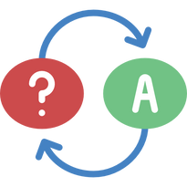







Methodology
All Students Take the General Quiz
Analyze Results and Divide Students into Levels
Generate Adaptive Quizzes for Each Level
Students Take Level-Specific Quiz
Upload Lecture Materials to System
System Generates a General Quiz
Analyze Results and Update Levels
Summative Assignment Preparation
If Progress is Low Generate Alert to Instructor
Display Progress on Dashboard
Generate Automatic Feedback for Each Quiz
IT21360428 | MONALI G.M.N. | 24-25J-112

Slide 62


System Diagram
Web Application
Input lecture content
Intelligent system
levels Identification
Generates Adaptive Quiz
Intelligent system
IT21302862 | SRI SAMADHI LASS | 2024-25J-112

Slide 63
Technologies and Techniques
Technologies | Techniques
React | Adaptive Learning Technique
Express | Data Pre-processing
Nodejs
Mongo DB
IT21360428 | MONALI G.M.N. | 24-25J-112

Slide 64


Requirments
Functional Requirements | Non Functional Requirements | Software Requirements | Personal Requirements
Adaptive Quiz Generation Alert System Feedback Mechanism Progress Dashboard | Performance Scalability Usability Reliability | Adaptive Algorithms Grading System Notification System | Instructor Involvement Student Engagement
IT21360428 | MONALI G.M.N. | 24-25J-112

Slide 65
MiStudy
Work breakdown
Initiation
Planing
Design
Implementation
Testing
Closeout
Define project scope and objectives
Develop project plan and timeline
Algorithms for quiz adaptation
Develop and integrate adaptive quiz algorithms
Unit Testing
Review project deliverables and ensure all objectives are met
Identify risks and create mitigation strategies
Notification and alert mechanisms
System Testing
Conduct initial research and feasibility study
Implement notification system
Conduct final project review and documentation
Integration Testing
Feedback templates, and create a progress dashboard
Implement personalized feedback features and dashboard
Define requirements and deliverables
IT21360428 | MONALI G.M.N. | 24-25J-112

Slide 66
Gantt Chart
IT21360428 | MONALI G.M.N. | 24-25J-112

Slide 67
References
[ 1] | Kang, Lys. "Personalized Quiz Maker: Novel feature for Alby learning management system." (2024).
[2] | Driouech, Ouadi, Hongjoon Park, and Youngcook Jun. "A Quiz Generator Extension inside CMS for Mathematics Learning." Thirteenth Asian Technology Conference in Mathematics. 2008.
[3] | Ledi, Agbeyeye K. "Automatic Quiz Generation System-Using Natural Language Processing." (2022).
[4] | https://www.revisely.com/quiz-generator
[5] | Alhazmi, Abdulsalam K., et al. "Success and Failure Aspects of LMS in E-Learning Systems." International Journal of Interactive Mobile Technologies 15.11 (2021).
IT21360428 | MONALI G.M.N. | 24-25J-112

Slide 68
Commercialisation
Provide this application as a plugin for existing LMS.
Connecting via API endpoint.
Get doucments (pdf, word, pptx etc.)
Extracting data from them.
Save extracted data in the system.
Provide learner centric interface to the existing LMS.
Provide a online platform for student where they can register and use the system by uploading there documents.
IT21251900 | RAJAPAKSHA R.M.S.D | 2024-25J-112

Slide 69
System Diagram
2024-25J-112

Slide 70
THANK YOU!
2024-25J-112

